Slide 1



The Ultimate in Quality & Innovation
Company Overview
Over 25 years of experience working with manufacturing facilities to achieve high performance targets, flexibility, increased margins and reduction in energy consumption to improve the overall manufacturing performance.
At UMS Industries, we believe in technological advancement, long-term relationships and extensive knowledge about smart manufacturing.

Slide 2

History & Vision
Serving the automotive industry with application engineering, turnkey machining, fabrication and build, automation, and tools for all types of assemblies.
Engineering Solutions.
Project Management.
Painting Applications
Business approach : Continuous improvement and teamwork.
Highest industrial standards for quality, technology, value and services.
UMS Industries has outlined the Global Optimized Organization Grid (GOOD) that includes the ability to manufacture, service, support our commitments at locations around the globe.

Slide 3
Why UMS Industries?
Automation Division:
Operationally:
Experienced in developing and implementing fully automated flex cells with interchangeable plates, manual workstations & tabletop poke yoke fixtures. For all your pre-production needs we can make customized tooling, components, workstations and assembly lines.
In house design, manufacturing and Testing facility. Machine & “turnkey solution” provider.
Full engineering capability (mechanical / electrical, controls & simulation engineering).
Adaptable to building and designing as per customer requirements.
Benefits of Working with UMS:
Financially:
Training and plant integration.
Efficient part flow & streamlined manufacturing process.
To keep up with increasing production volumes and to maximize ROI.
Eliminate human errors which result in poor quality and inconsistency.
For real time production data and for connecting CMS results to deliver better OEE.
Cost efficient with a positive financial track record.
Strong relationship with our financial partners.
Customer Support:
High level of expertise in project management.
Full engineering support from product to equipment design and build. On-site engineering support.

Slide 4
OUR VISION / OUR MISSION
Vision, Quality & Commitment
OUR COMMITMENT
QUALITY POLICY
You place your trust in us: We give a firm commitment.
UMS supplies reliable and maintainable equipment and/or services that meet or exceed our customer requirements, with emphasis placed on quality and on time delivery.
To become an excellent provider of systems andcomponents for the automotive, aerospace, new power generation & other industries.
For all your projects, UMS Industries service undertakes for:
Guarantee the performance of your installations.
Serving our customers with innovative solution. Providing cost efficient “second to none” production systems and products.
Top management, employees and supply chain commitment to a continuous quality improvement philosophy, that is focused on open communication and customer satisfaction.
We will continue to focus on improvements to assist our
customer to become more competitive.
Study and report the availability rate of your production facility by:
Continuous growth with our customers, suppliers and financial partners.
Reducing servicing times.
Improving actual reliability all minimize the number of production shutdowns.
Spare parts management: controlling consumption in transparent mode, securing productivity increases all optimize the financial aspect of your maintenance contracts.
We will exceed all your expectations!
Our quality objectives and measurables are the foundation and benchmark for continuous improvement.
Standing strong with our commitment for on time delivery and quality.
4

Slide 5
Solutions & Services
Integration
Welding and Fabricating
Machining & Machine Tool
Assembly Automation
Engineering solutions
Body-in-White
Retool
Transfer Automation
Robotic Technology
Metal Forming
PFMEA Development Proactive
Value Added Analysis - Lowest Capital Investment
Process Development - Idea Generation
Logistics
Quick Turn-key Solutions
Error proofing technology
Cross border convenience.
Ultrasonic Punching & Welding Machines, Sonic/Hot Plate/ Spin Welding
Wet- Out Machine, Dispensing, Finishing, Bonding & Adhesive Apply Systems, De- gate System
Palletized Automation, Bowl Feeder
Screws, Clip /Nuts/ Fastener / Rivet Install
Leak Test Station, Validation / End-of-Line Test Systems, Vison System
Flexible Tooling Cartridges & Base Machines
Punch Die & Presses, Ultrasonic Fascia Hole punching
Robots Integration, Rotary Transfer
Index Machines, Boring, Pallet Transfer
System , Vertical Cooling System
Material handling & Removal
Quality Inspection, Painting
Simultaneous engineering study,
design, manufacture
Installation and maintenance
Equipped with a complete range of
machinery and ample
Foor space to suit customer needs
On-Site Support

Slide 6


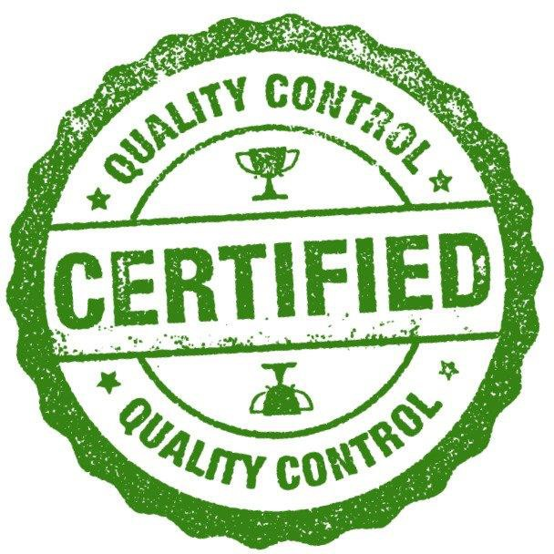
CERTIFICATION & NAICS CODES
Certification & NAICS Codes
CERTIFICATION:
Quality Assurance - ISO 9001/2015
Third Party Inspection (P.ENG)
ESA (Electrical Safety Authority)
Customer Assembly machine standards
CWB Certified
Canada Controlled Goods/ITAR Compliant
CAMSC/NMSDC Certified
MBE/WBE Certified
The North American Industry
Classification System Codes
541511 - Programming, Robotics, Automation software design / development services
238210 - Electrical, Wiring Installation
Contractors, Building automation system
541512 - Computer Systems Design Services
541330 - Engineering Services
3559/ 3569 - Industry Machinery, Robots,
plastics: for molding and forming
6

Slide 7
ABOUT AUTOMATION DIVISION
About Automation Division
Software Capabilities
Core Capabilities
Design Capabilities: SolidWorks (3D Cad models & Drawings)
Software Capabilities: Siemens, Allen Bradley, Omron & Robot Programming
HMI/ PLC/Robot Programming, Factory Automation, RFID & SCADA
Project Management, Mechanical Design & Electrical Design
Fabrication, Machining, Panel Build, Controls & Mechanical Assembly
Controls Programming, , Service Manuals, Assembly & Sub-Assembly
Custom design, build to spec
Design, build, commissioning, troubleshooting, Validation and Run-off support & Training
Machine & plant integration
7

Slide 8

OUR TEAM
Our Team
Roberto Garcia, COO Chief Operating Officer, Cell: +1- 519- 257- 9906, rgarcia@ums-industries.com
30 years of Industrial Engineering, Automotive expertise, and Project Management.
Operations and Plant Management.
Safraz Rahaman, Operations Manager, Cell: +1- 519-996-4244, srahaman@ums-industries.com
26 years in automotive in Tooling. Build, design and maintenance.
Electronic background. Building and servicing digital weigh scales and flow control of granular materials for the food industries.
Machine builder of automation lines serving automotive for gears transfers automobile transmission.
Harpreet Joshi, Application Engineer, Cell: +1-519-990-6915, hjoshi@ums-industries.com
12 years Automotive Industrial experience.
Building Automated machines for entire programs for Interior / Exterior Automotive parts: Pillars,
Facia, Center Console etc. for GM, Ford, Rivian, Stellantis, and Range Rover.
Expert teams: Our team includes highly skilled professionals, inhouse designing and engineering department, Programmers, Machine builders and account managers.
Alex Pallares, Automation and Fabrication Designer, Cell: +1-519-999-1801, apallares@ums-industries.com
10 years of designing experience for Automation and Fabrication equipments.
12 years of data management, fabrication, designing and cost estimation experience.
8

Slide 9
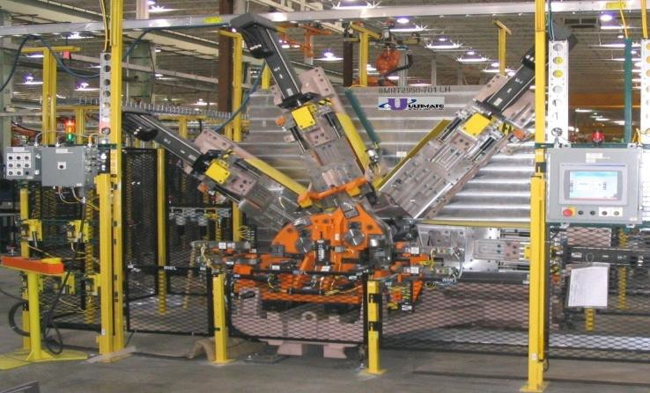
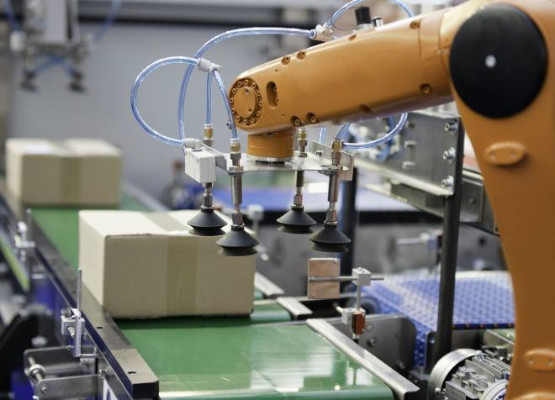
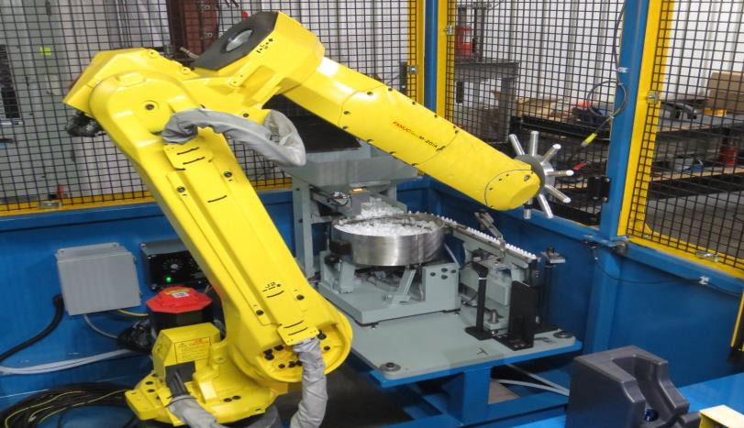
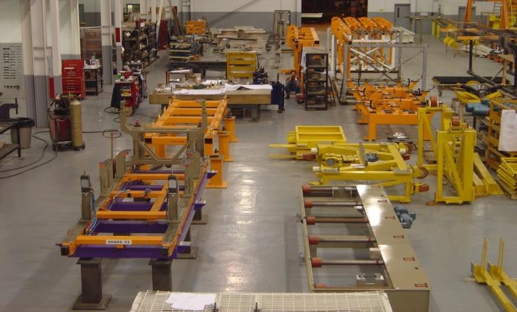
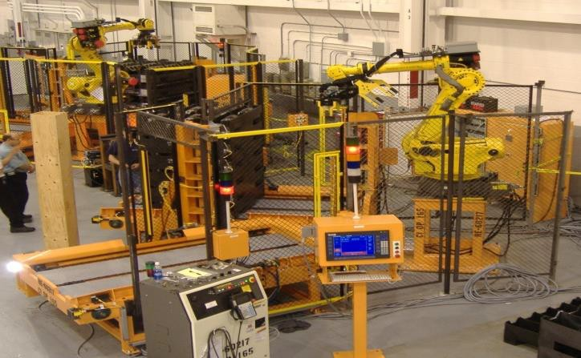
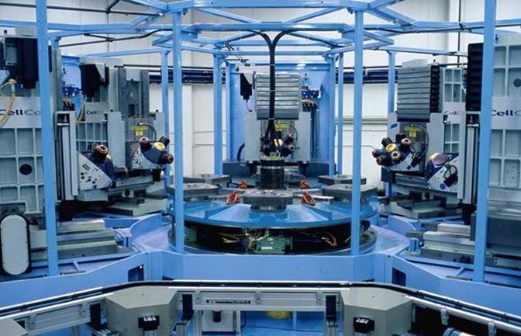
AUTOMATION PAST PROJECTS
Automation Past Projects
Flange Bender Station
Material Handling Robot
Robotic Clip Install Assembly Line
Roll Beds & Carriers
V6 Dunnage Handling
Dial Table

Slide 10
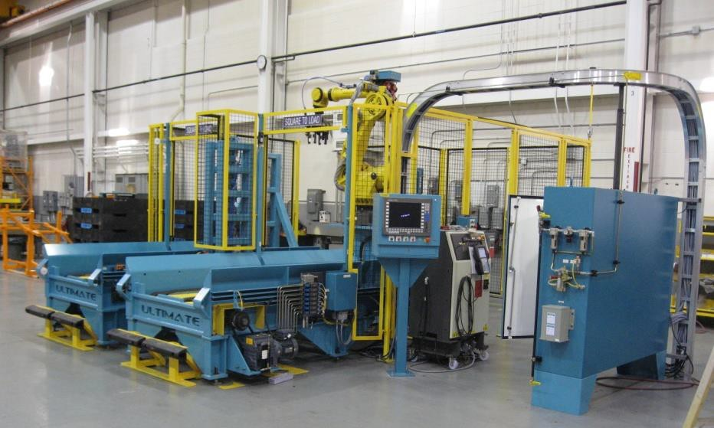
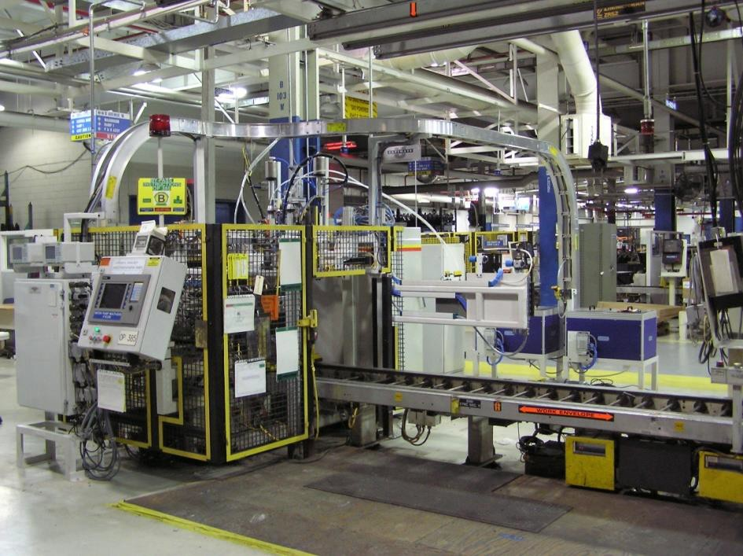
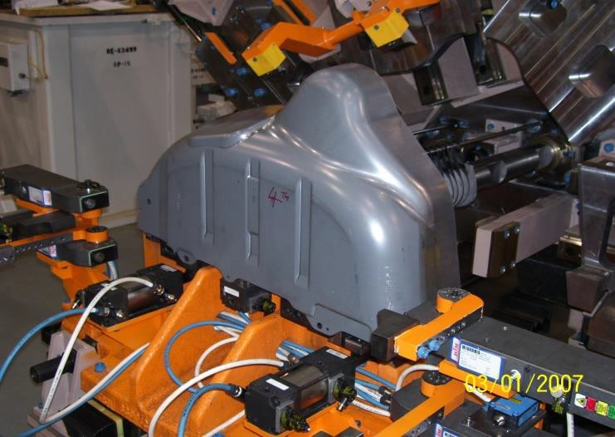
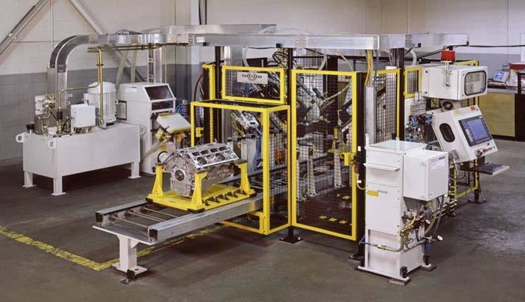
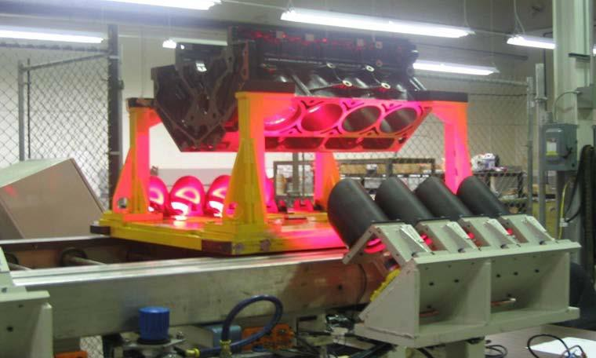
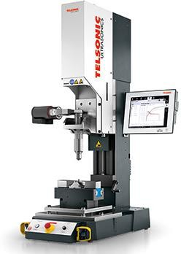
AUTOMATION PAST PROJECTS
Automation Past Projects
GM Dunnage System
Avseal & Probe Station
Flange Bend Station
10
Dowel & Cup Press
Portable Welding Machine
Piston Identification Cell
(with vision)

Slide 11


AUTOMATION ROI CALCULATOR
Automation ROI Calculator
At UMS, we specialize in automation solutions your manufacturing operations for staffing issues or turnover. Case in Point:
that
de-risk
A recently completed project for a local company was done for Lazer
Metals. Lazer Metals always believed that they could never afford the
investment in Automation. They are a small shop, making approximately 5M annual revenues from online sales of their ornamental products sold on Amazon. However, as Henry Ford famously said, "If you need a machine and don't buy it, then you will ultimately find out you have paid for it and don't have it."
When Lazer Metals adopted our automated packaging station, they achieved:
A 25% boost in production efficiency.
A 30% reduction in quality errors (mislabelling alone costs Lazer 12k annually!).
Total ROI in just 9 months.
Our ROI calculator can provide a customized estimate of your business's potential savings and efficiency gains.
We are looking forward to helping Manufacturing customers achieve its full potential!
ROBOTIC ROI CALCULATOR

Slide 12
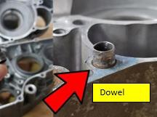
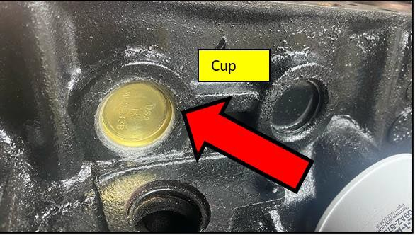
Case Study 1: Dowel & Cup Press
Automotive casting required two 8mm dowel pins to be pressed into machined holes.
Determine force and depth feedback.
Press fit result deformation of the aluminum casting.
Machine to perform various checks.
1
2
Need
Challenge
5
3
ROI
Solution
A 25% boost in production
efficiency.
A 30% reduction in quality errors.
Total ROI in just 1 Year.
Developed high-quality equipment within tight deadline.
12
Benefits
4
Low cycles time , High speed assembly.
Eliminated human error.
Guarantees an acceptable casting shipping to customer.

Slide 13
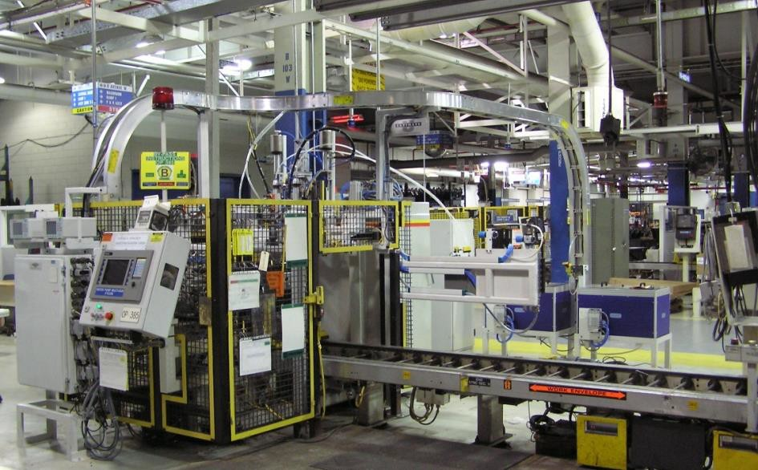
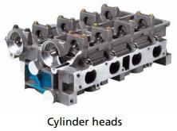
Case Study 2: Avseal Installation & Probe/Inspection Station
Microscopic scale inspection required on engine blocks the ability to measure and characterize the properties.
Ultimate Avseal automated system was able to install 3 plugs in 12 seconds.
Automotive manufacturer requires blind sealing plugs installed on parts with high precision.
1
2
Need
Challenge
5
ROI
Solution
3
Developed high-quality equipment within tight deadline.
A 35% boost in production efficiency.
A 40% reduction in quality errors.
Total ROI in just 2 Year.
Benefits
4
Low cycles time , High speed assembly.
Eliminated human error.
Guarantees an acceptable casting shipping to customer.

Slide 14
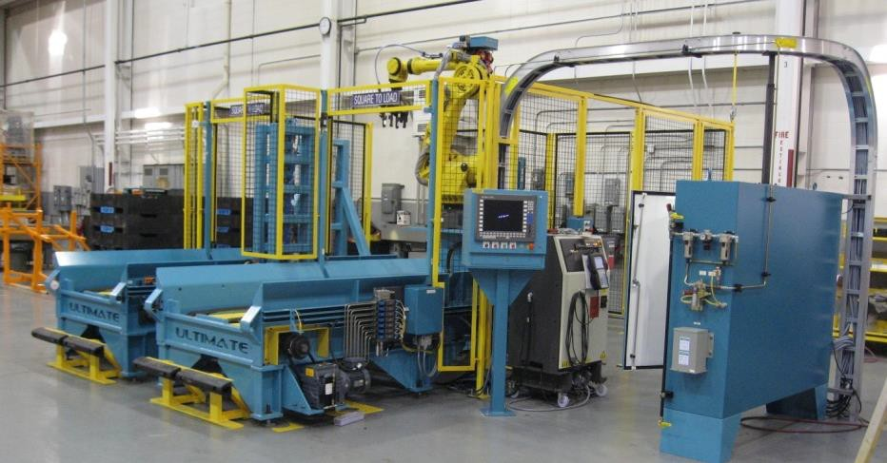
Case Study 3: Crank Case Dunnage Handling – GM Powertrain
The design intent of the Dunnage Handling Systems (Space Manager) is to provide a buffer or access point to load/unload the part flow between machine processes.
Manufacturing plant faced significant challenges primarily due to the time- consuming process of separating empty or full stacked dunnage.
The traditional method created several operational inefficiencies: Long, unplanned queues of trucks formed at the loading area due to mixing of containers.
1
2
Need
Challenge
3
ROI
Solution
Developed high-quality equipment within tight deadline.
Cost Savings
Reduced Waste
Time Efficiency
Streamlined Operations
5
A 50% boost in production efficiency.
A 40% reduction in quality errors.
Total ROI in just 1 Year.
Benefits
4
Low cycles time , High speed assembly.
Eliminated human error.
Guarantees an acceptable casting shipping to customer.

Slide 15
Case Study 4: Flange Bender Station
Car bodies panels Flanging machine.
Complex flanging operation & high production volume.
Fully automatic machine with automatic tool changers & programmable controls to increase efficiency and accuracy.
Parts required without rough edges
Precise dimensions from machine
Bending strengthens the sheet metal and provided reference points for alignment during assembly and welding.
1
2
N
eed
Challenge
5
3
ROI
Solution
Automation
Smart Sensors and
IoT Integration
Advanced Control Systems
4
A 25% boost in production efficiency.
A 30% reduction in quality errors.
Total ROI in just 2 Year.
Benefits
Improved productivity compared to manual machines
Enhanced consistency and accuracy
Reduced operator fatigue and error

Slide 16
ABOUT FABRICATION DIVISION
About Fabrication Division
Industries Serving :
Design Capabilities :
SolidWorks (3D Cad modeling
Aerospace & Agriculture
Automotive
Consumer Goods & Construction
Electronics, Food & Beverages
Metals & Manufacturing
Medical, Textile & Packaging
& Drawings )
Testing And Quality Measures In Place For :
- Fitting, Welding, Blasting, Flatness, Assembly & Paint Inspection
Manpower :
Fabrication Applications :
Industrial Designers, Electricians, Painters & Welders
Custom Fabrication
Carbon Steel & Stainless Steel
Aluminum
Machining & Custom Finishing
Welding: Tig, Mig, Arc & Fusion
Quality Inspection
Assembly & Sub- Assembly
Custom Design & Build To Spec
Machining Capabilities :
MIG & TIG Welding Equipment
Plasma Cutter, Bandsaw, Lathe & Surface Grinder
Oversize Paint Booth

Slide 17
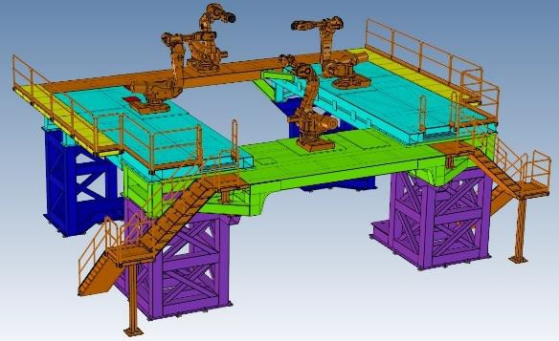
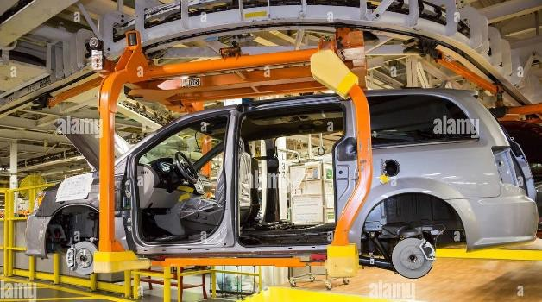
FABRICATION PAST PROJECTS
Fabrication Past Projects
17
Robot Assembly Line Platforms
Automotive Carriers

Slide 18
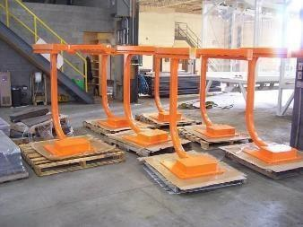
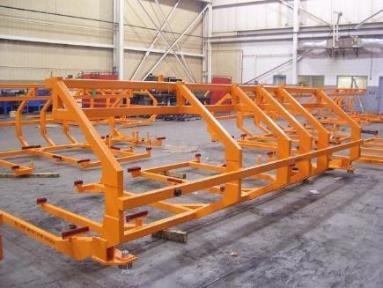
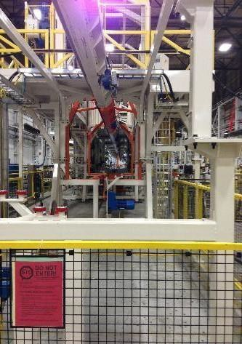
FABRICATION PAST PROJECTS
Fabrication Past Projects
18
Assembly Line Modular
Structures
Part Conveyance
Specialty Carriers

Slide 19
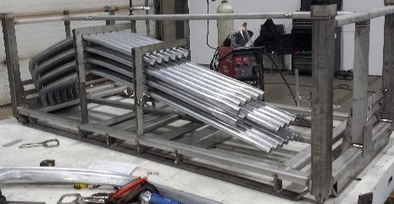
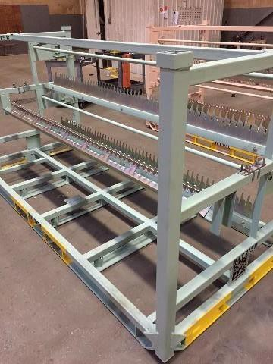
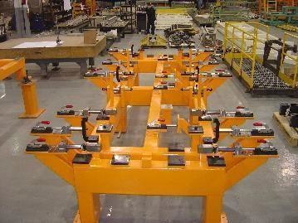
FABRICATION PAST PROJECTS
Fabrication Past Projects
Stainless Steel Carriers/Racks
Heat Treatable Painted
Carbon Racks
Large Workhold Fixtures

Slide 20
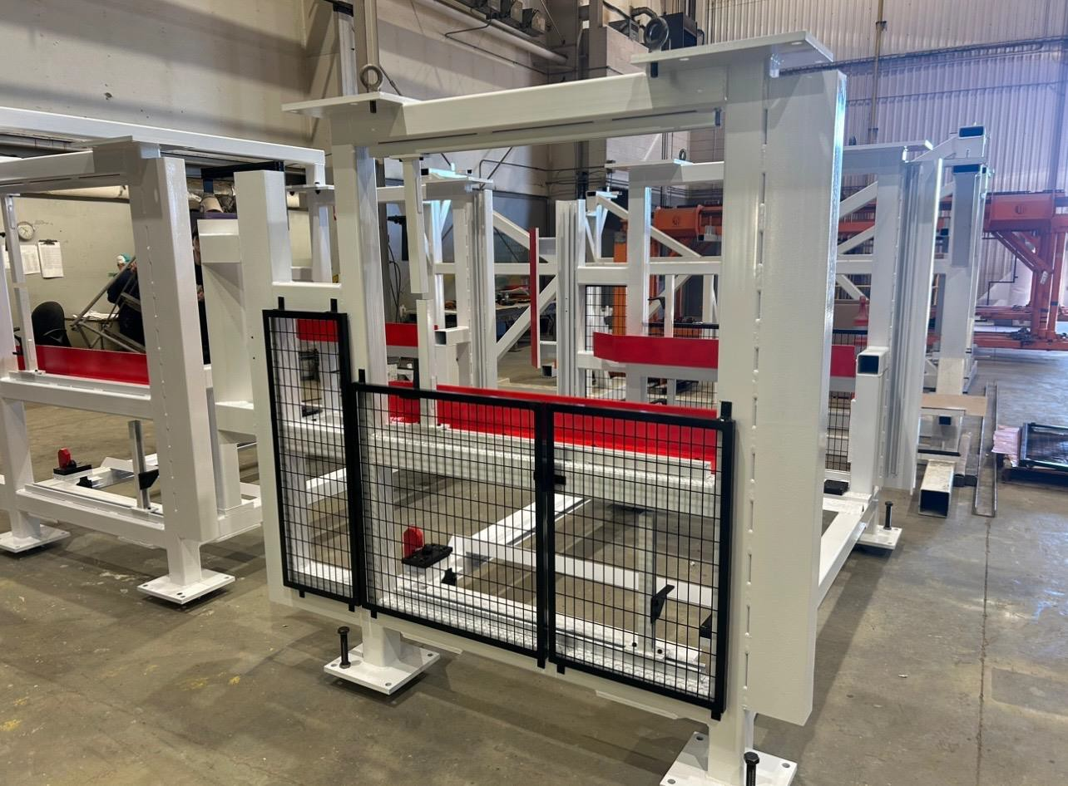
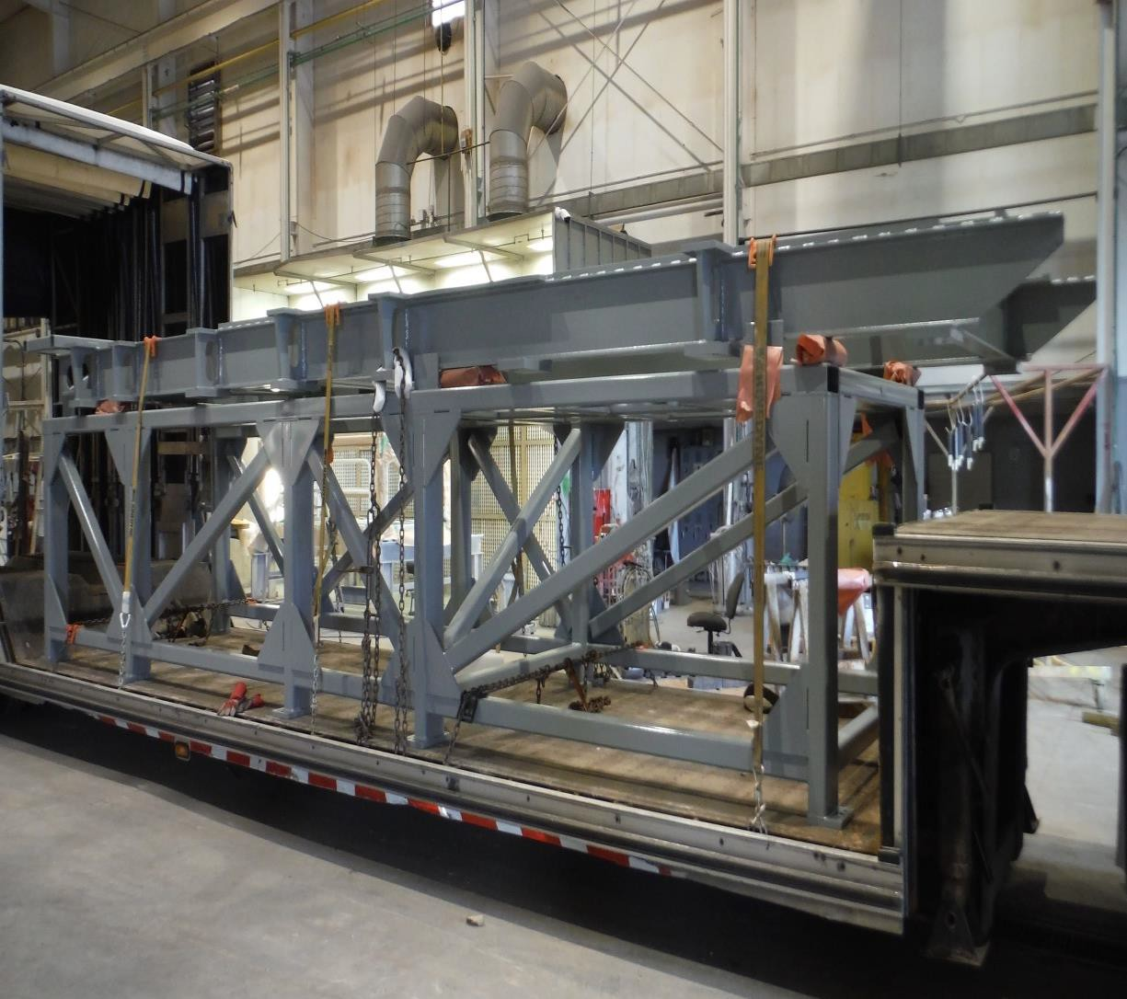
FABRICATION PAST PROJECTS
Fabrication Past Projects
Racks
Frame
Racks & Frames

Slide 21
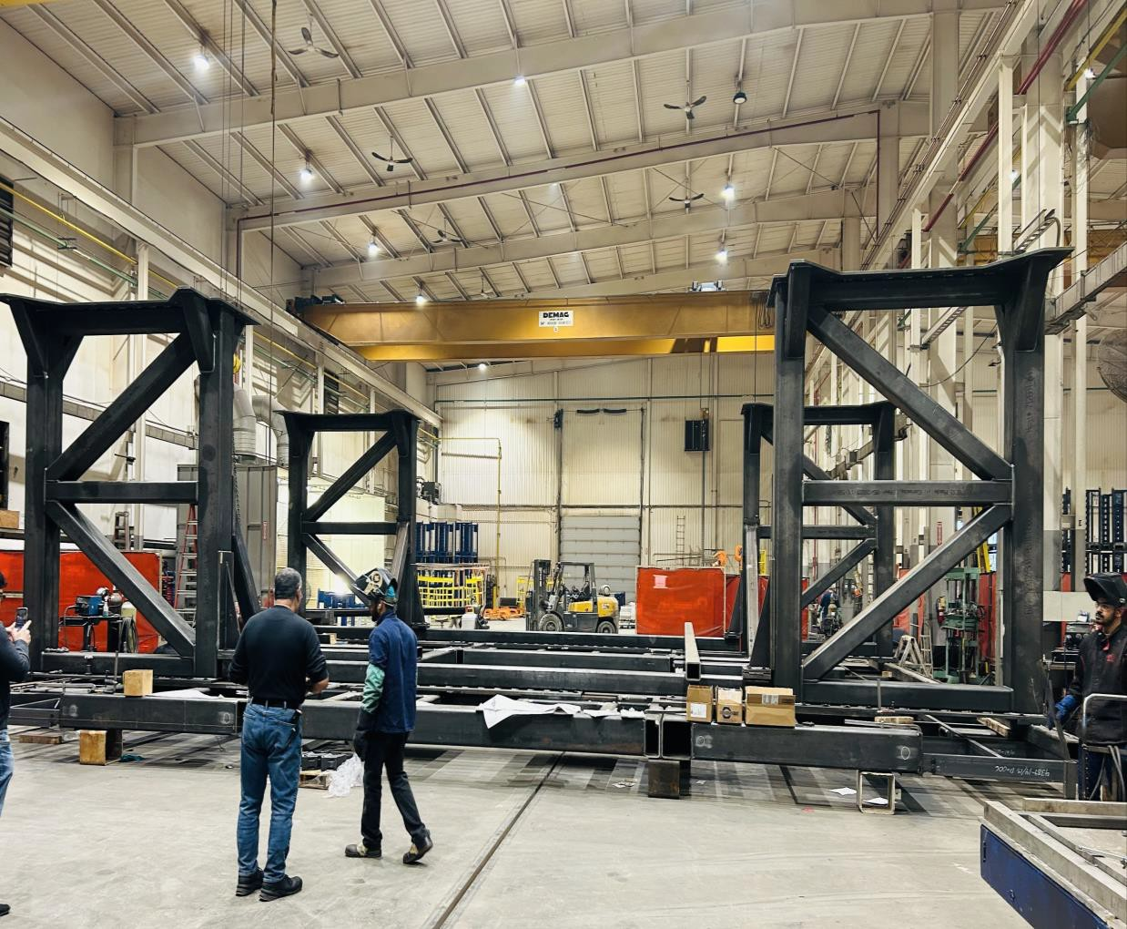
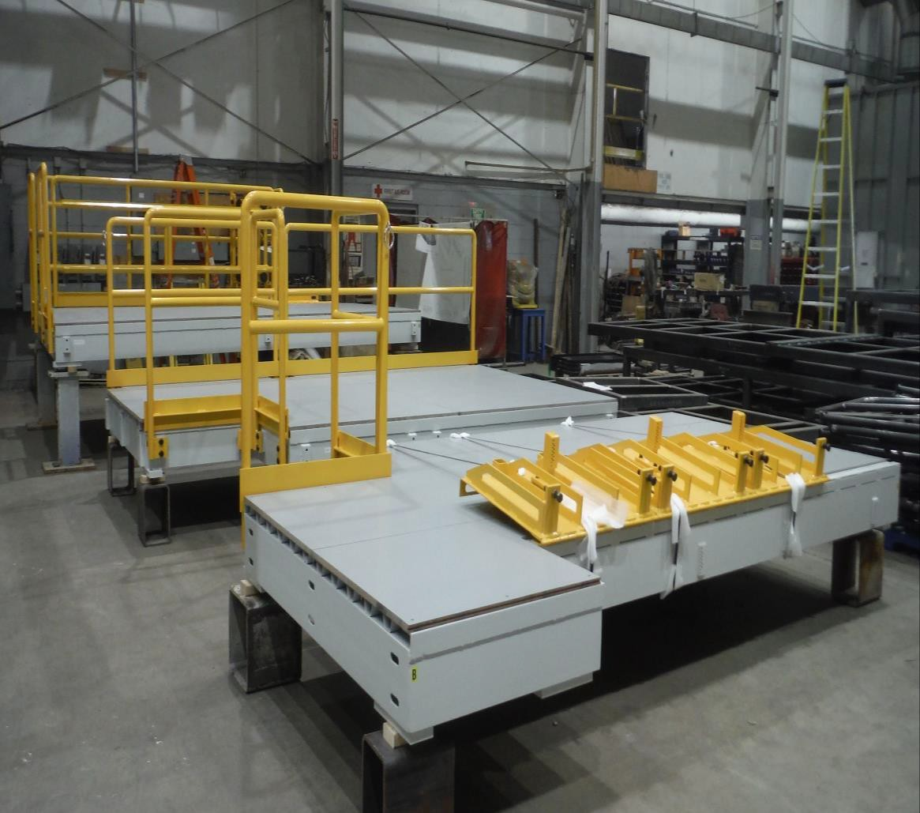
FABRICATION PAST PROJECTS
Fabrication Past Projects
Robotic Assembly Line Platforms

Slide 22
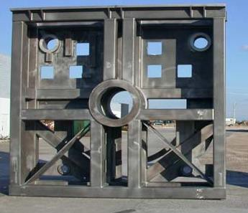
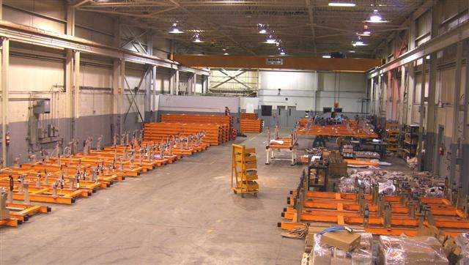
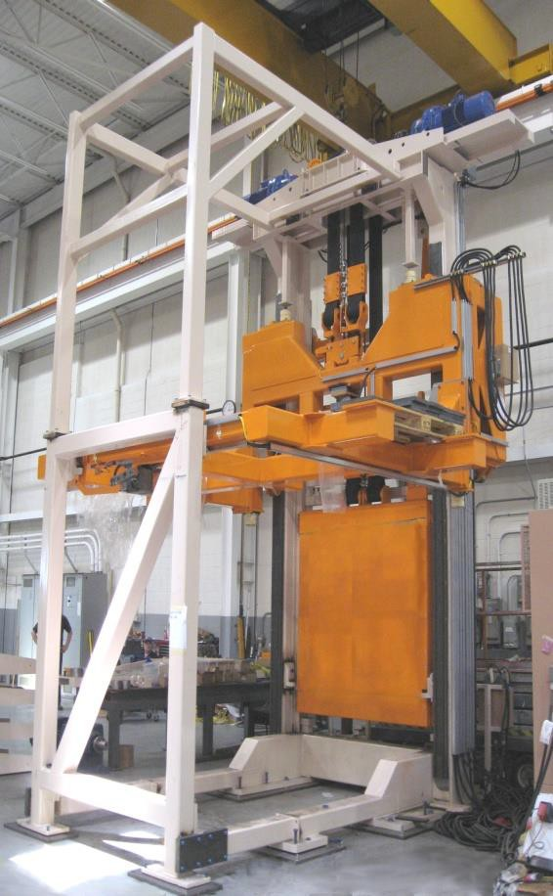
FABRICATION PAST PROJECTS
Fabrication Past Projects
Riser/Base Molding Station
Pallet Fabrications and Build
Elevator
Riser/Base Molding Station
Pallet Fabrication/Build
Elevator

Slide 23
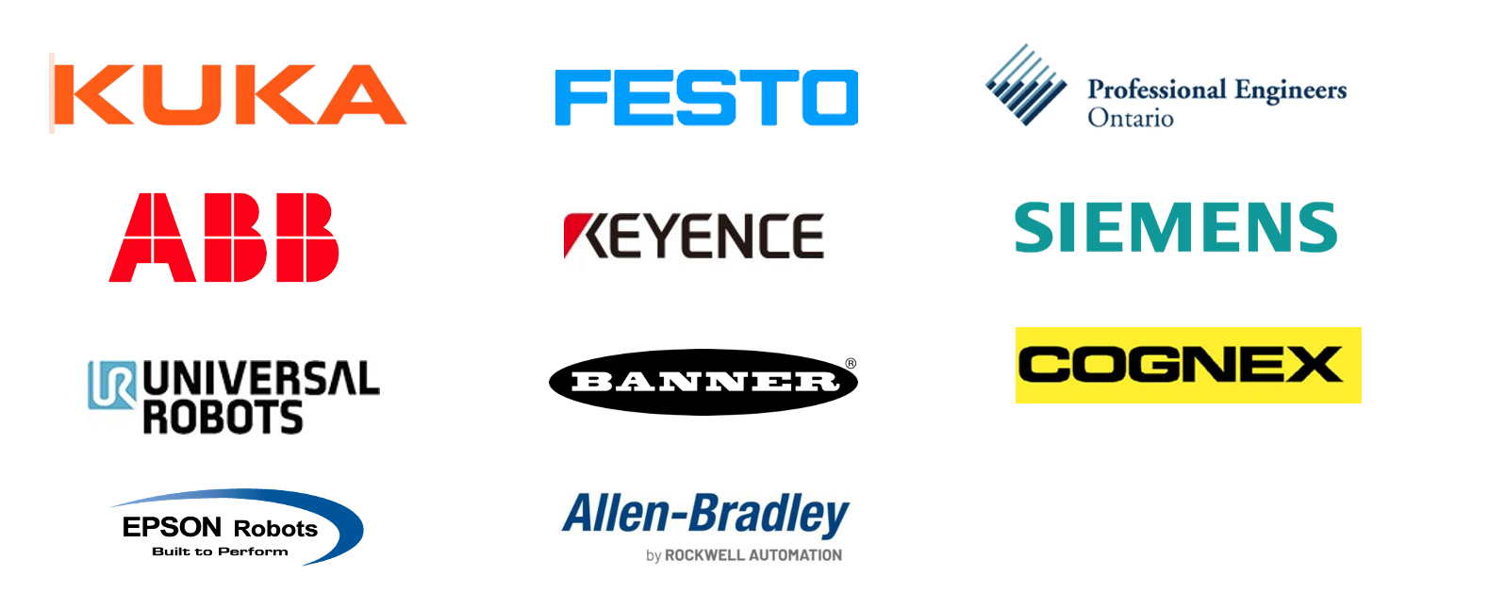



Industry Partners

Slide 24












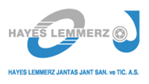








VALUED GLOBAL CUSTOMERS
Valued Global Customers

Slide 25
Headquarters: Oldcastle, Ontario, Canada
UMS Industries
Email: cad@ums-industries.com Web: www.ums-industries.com
Thank you for your time and future considerations

